Slide 1
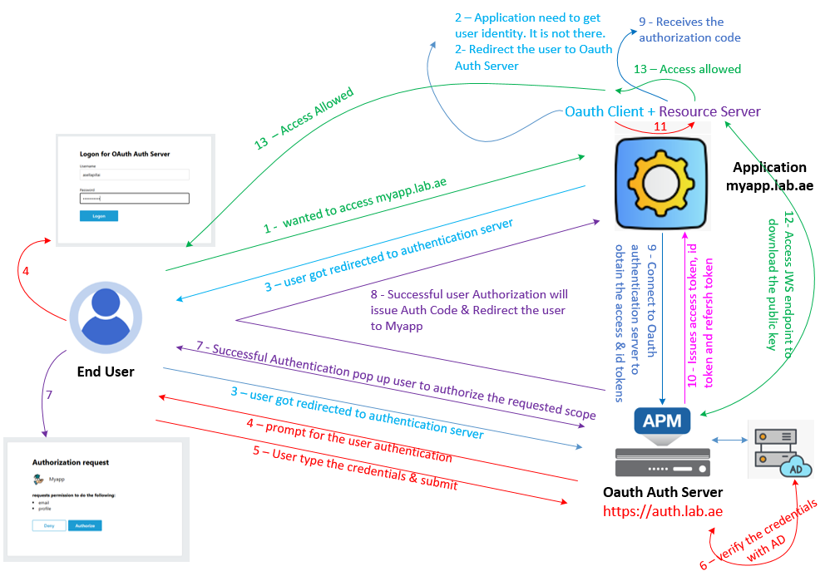
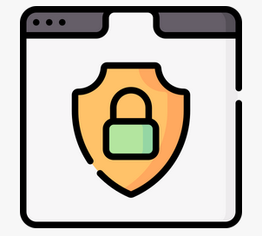

F5 APM Learning with Alexander S
Chapter 03 – Configure F5 APM as an OAuth Authorization Server using the OpenID Connect Authorization Code Flow

Slide 2
I highly recommended to watch Chapter 02 first,
Because that explains how APM operates as an OAuth Authorization Server using the Open ID Connect Code Flow,
Which provides you essential background for this chapter.

Slide 3
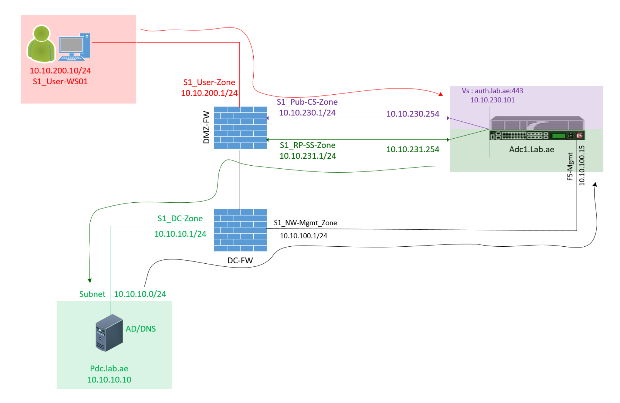
Our LAB Setup for the Oauth Testing
We access the F5 management IP from AD/DNS server https://10.10.100.15
10.10.10.10 --> 10.10.100.15:443
For the Oauth testing - User-WS1 access https://auth.lab.ae/
10.10.200.10 --> 10.10.230.101:443
F5 Server Side Self IP (10.10.231.254) connect to AD (10.10.10.10) for user authentication and AD query using ldap port tcp/389
10.10.231.254 --> 10.10.10.10:389

Slide 4
Implementation Steps
Step 01: Let us decide the virtual server IP & Hostname
Step 02 - Let us create the DNS record to access the virtual server auth.lab.ae.
Step 03 - Let us test the virtual server hostname using NS lookup command from the User Workstation
Step 04 - Let us create the Client SSL Profile for the virtual server hostname
Step 05 - Let us create the Virtual Server
Step 06 - Let us create JSON Web Token key
Step 07 - Let us create JSON Web token
Step 08 - Create JSON Web Token Provider
Step 09 - Create JSON Web Token Provider List
Step 10 : Let us configure the Scope & Claims
Step 12 - Let us configure the oAuth profile
Step 13 - Let us create the Active Directory authentication service.
Step 14 - Let us create the APM Access Profile
Step 15 - Let us attach the configured APM access Profile into the Virtual Server.

Slide 5
Step 01: Let us decide the virtual server IP & Hostname
Vs Host Name is auth.lab.ae
Vs IP Address is 10.10.230.101

Slide 6
Step 02 - Let us create the DNS record to access the virtual server auth.lab.ae.
Step 03 - Let us test the virtual server hostname using NS lookup command from the User Workstation

Slide 7
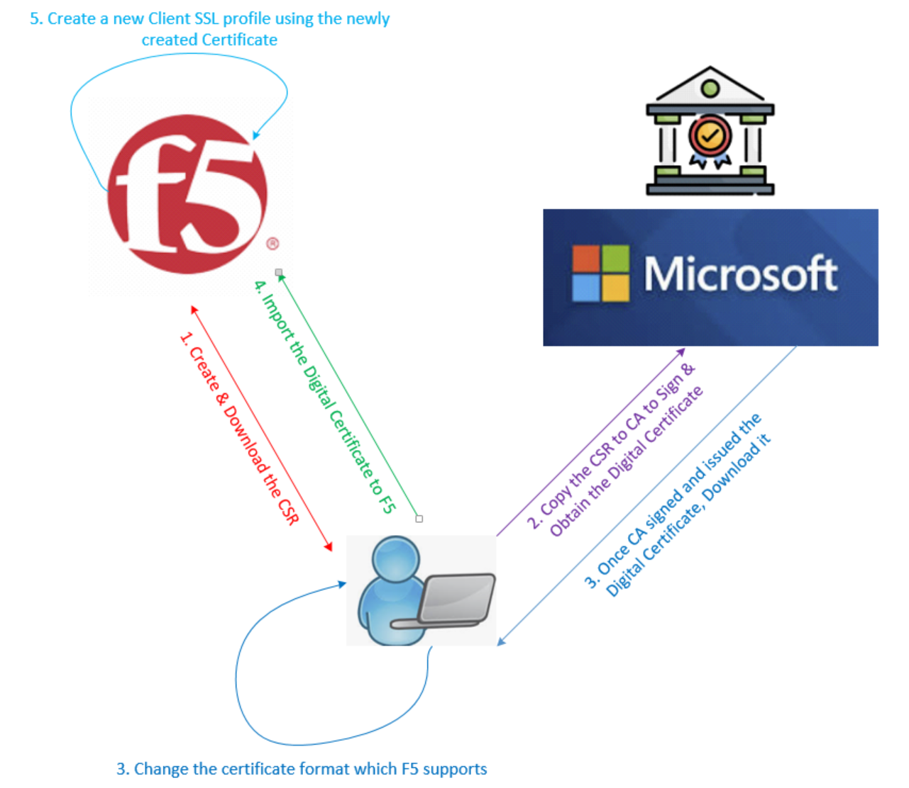
Step 04 - Let us create the Client SSL Profile for the virtual server hostname
I have created the Certificate Signing Request (CSR), generated the certificate using local Domain CA, and imported it successfully.
Also, i have configured the Client SSL Profile using that newly created certificate.
If you’re not familiar with this process, please watch the other video linked in the YouTube description for detailed steps.
F5 LTM Learning Series – Bonus Chapter 02 - Create CA Signed Certificate & Configure Client SSL
https://www.youtube.com/watch?v=7KeUsTiwbfE

Slide 8
Step 05 - Let us create the Virtual Server
Step 06 - Let us create JSON Web Token key
Step 07 - Let us create JSON Web token
Step 08 - Create JSON Web Token Provider
Step 09 - Create JSON Web Token Provider List

Slide 9
Step 10 : Let us configure the Scope & Claims
Prior to configure - let us understand what is Scope and Claims.
Scope tells what level of access an oAuth client is requesting to oAuth Auth Server.
Claims tells what information about the user is included in a token by oAuth Server to oAuth Client.
In other words, the OAuth Authorization Server reads the scope values from the client’s request and then issues the token with corresponding claims based on that scope.
In our case, we have mutually agreed to provide the following claims when the OAuth client includes these scopes in its request to the Authorization Server:
profile → includes the user’s name (to display the username after login)
email → includes the user’s email address (used for authorization and granting access to the application)

Slide 10
Step 10 : Let us configure the Scope & Claims
Scope Name & Values
email %{session.ad.last.attr.mail}
profile %{session.ad.last.attr.displayName}
Claim Name & Values
email %{session.ad.last.attr.mail}
profile %{session.ad.last.attr.displayName}

Slide 11
Step 10 : Let us configure the Scope & Claims
The attributes displayName and mail are Active Directory attributes, and they are retrieved using an AD Query.
In this lab, the OAuth client is requesting two scope values which is email and profile.
In your environment, you may need to configure additional claims depending on the scope values requested by the client.

Slide 12
Step 11 - Let us configure the Client Application
Prior to configure the client application let us understand the purpose of Client Application.
Every OAuth client uses this value when it registers with the OAuth authorization server.
It’s a good security practice to create a separate client application for each OAuth client for the registration.
Client Application

Slide 13
Step 12 - Let us configure the oAuth profile
Step 13 - Let us create the Active Directory authentication service.
Configure the AD Health Monitor
Configure the AD authentication
Step 14 - Let us create the APM Access Profile
Step 15 - Let us attach the configured APM access Profile into the Virtual Server.

Slide 14
Step 13 - Let us create the Active Directory authentication service
F5 Server Side Self IP (10.10.231.254) connect to AD (10.10.10.10) for user authentication and AD query using ldap port tcp/389
10.10.231.254 --> 10.10.10.10:389
Power Shell AD test command
Syntax : adtest -t auth -r "lab.ae" -u <ad-username> -w <password>
Command: adtest -t auth -r "lab.ae" -u shiva -w P@ssw0rd

Slide 15
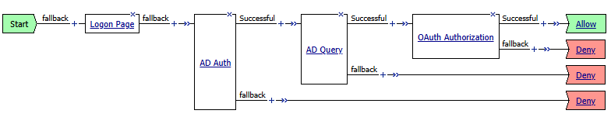
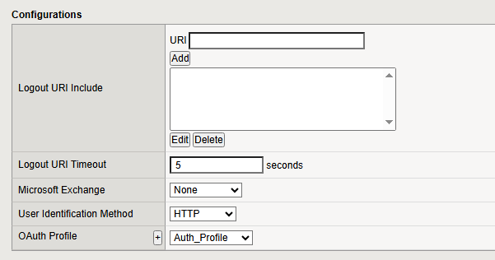
Step 14 - Let us create the APM Access Profile
This Access Profile uses the OAuth-Auth Profile to check and verify the OAuth client’s registration details.
It then performs AD Authentication to verify the end user’s login credentials.
Based on Successful authentication, it uses AD Query to retrieves the user information from Active Directory
This information is used to "match and provide" the correct OAuth scope values.
Finally, the OAuth-Authorization agent approves the allowed scopes and issues tokens with user claims.

Slide 16
Step 12 - Let us configure the oAuth profile
Step 13 - Let us create the Active Directory authentication service.
Configure the AD Health Monitor
Configure the AD authentication
Step 14 - Let us create the APM Access Profile
Scope Message - Hey %{session.ad.last.attr.givenName}! The APP Oidc-Debugger Requesting your permission to access the below.
Step 15 - Let us attach the configured APM access Profile into the Virtual Server.

Slide 17
This concludes Chapter 03, where we have configured F5 APM as an OAuth Authorization Server using the OpenID Connect Authorization Code Flow. Please continue watching Chapter04. 👉 In Chapter 04, we’ll move on to testing the OAuth Authorization Code Flow using tools such as the OIDC Debugger and Postman. Thank you for watching!!!
Chapter 03 – Configure F5 APM as an OAuth Authorization Server using the OpenID Connect Authorization Code Flow

